Slide 1

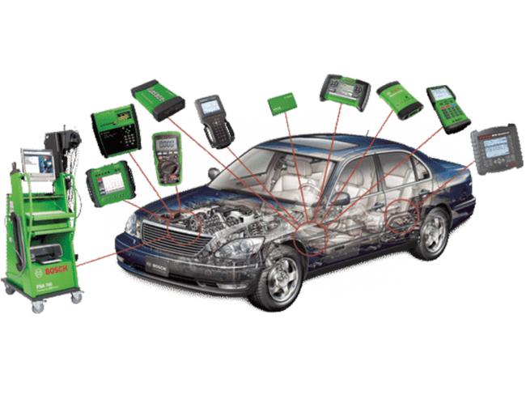
INTRODUCTION
UNIT 1.0
Introduction to
Auto-Diagnostic
System
Exploring Tools, Technologies, and Techniques in Auto Diagnostics

Slide 2

Overview
Auto diagnostic systems are essential for modern vehicle performance, safety, and reliability.
They serve as the vehicle’s internal monitoring and troubleshooting unit.
This unit introduces diagnostic system functionality, importance, and technological evolution.

Slide 3
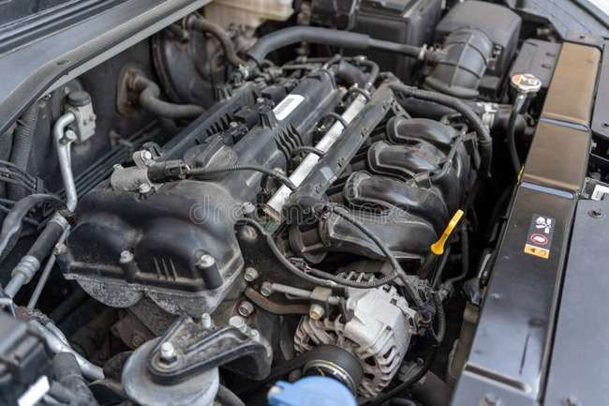
What Are Auto Diagnostic Systems?
What it is:
A system that detects, analyzes, and reports vehicle issues.
Why it matters:
Keeps vehicles safe, efficient, and running smoothly.
Core parts:
Sensors, Control Modules, Actuators, OBD Port

Slide 4
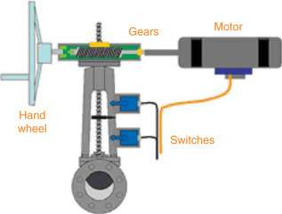
Key Components of Auto Diagnostic Systems
Sensors: Detect engine speed, temperature, oxygen levels, etc.
Control Modules: Process data and manage systems (engine, brakes, etc.).
Actuators: Adjust fuel injectors, ignition timing, valve timing, etc.
OBD Interface: Port to access trouble codes and system information.

Slide 5
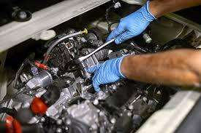

Functions of Auto Diagnostic Systems
Monitoring vehicle parameters
Analysis of data for fault detection
Reporting issues via DTCs
Communication with diagnostic tools

Slide 6
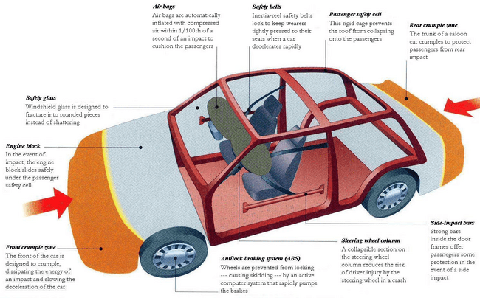
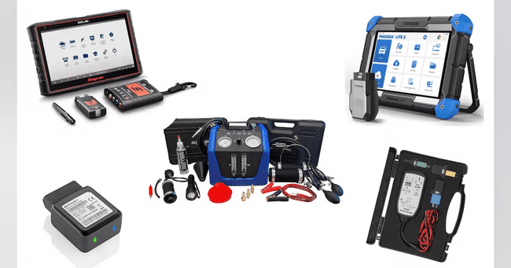
Principles of Operation
Data Interpretation:
Understanding sensor data and codes
Feedback Loop:
Continuous performance optimization
Fault Tolerance:
Fail-safe mechanisms to ensure safety
Diagnostic Protocols:
Use of OBD-II and standard interfaces

Slide 7
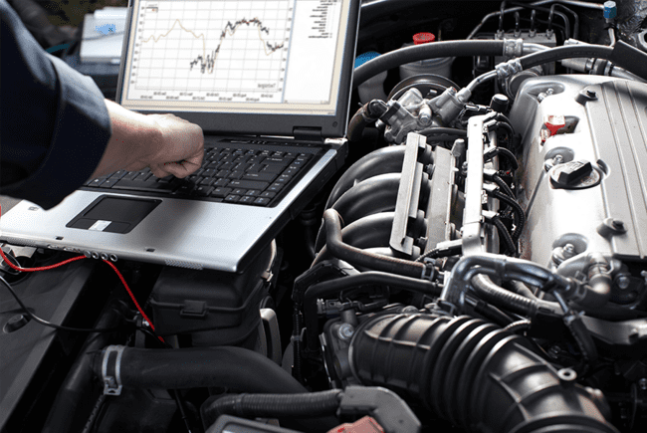
Importance of Diagnostics in Automotive Maintenance
Provides real-time monitoring of vehicle health
Enables proactive maintenance, preventing major issues
Enhances safety and reduces unexpected breakdowns
Cost-effective by catching issues early
Prolongs vehicle lifespan

Slide 8
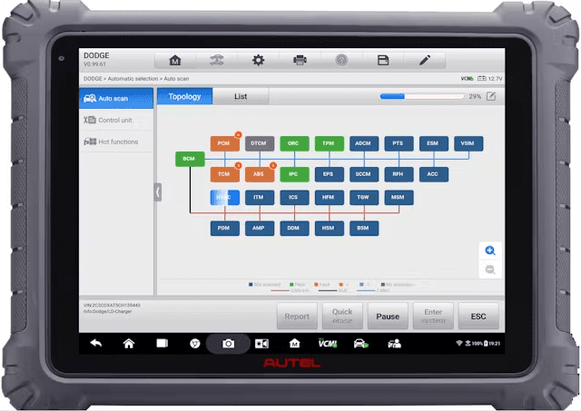
Evolution of Diagnostic Tools
Mechanical Diagnostics: Compression tests, visual checks
Electrical Diagnostics: Testing batteries, alternators
OBD Systems: OBD-I → OBD-II standardization
Computerized Diagnostics: Use of CAN networks
Advanced Tech: Artificial Intelligence, machine learning, predictive analytics

Slide 9

Conclusion
Auto diagnostics are vital for modern vehicle maintenance.
Helps in early fault detection and cost reduction.
Keeps vehicles safe and reliable.
Knowledge of diagnostics is essential in today's automotive world.

Slide 10

Self Assessment Preview
What is the primary purpose of auto diagnostic systems?
Name the main components and their functions.
What are the key functions of auto diagnostic systems?
Explain the feedback loop concept.
Why is proactive maintenance beneficial?
quote by richard branson

Slide 11
Self Assessment Preview
What is the primary purpose of auto diagnostic systems?
Name the main components and their functions.
What are the key functions of auto diagnostic systems?
Explain the feedback loop concept.
Why is proactive maintenance beneficial?
quote by richard branson

Slide 12
Key Takeaways
Vehicle diagnostics is essential for identifying and resolving performance issues.
Modern vehicles rely heavily on electronic systems, making diagnostics more complex.
Understanding vehicle systems and the need for preventive diagnostics improves efficiency and reduces breakdowns.
Technicians must be familiar with diagnostic protocols and standard procedures.

