Slide 1

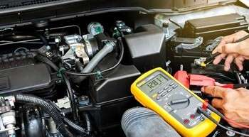
INTRODUCTION
UNIT 2.0
Engine Performance
Analysis
Foundations of Diagnosing & Optimizing
Engine Function

Slide 2
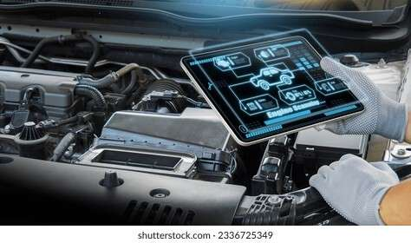
Introduction
Engine performance analysis is crucial for maintaining, diagnosing, and repairing automotive engines.
It focuses on understanding how engines operate, identifying performance issues, and interpreting diagnostic trouble codes to ensure engine efficiency and reliability.

Slide 3
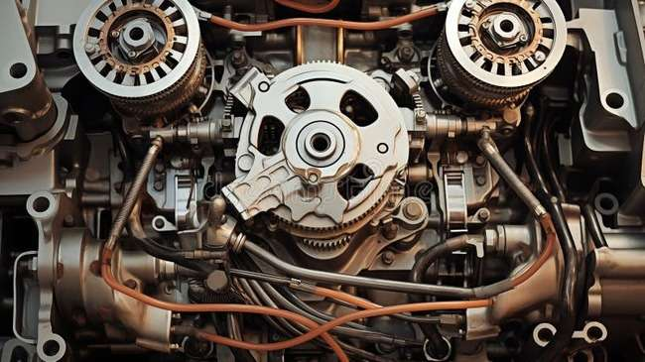

Understanding Engine Operation Principles
Four-Stroke Cycle
Intake: Air-fuel enters as piston moves down.
Compression: Mixture is compressed.
Power: Spark ignites the mixture; piston is forced down.
Exhaust: Burnt gases are expelled.

Slide 4
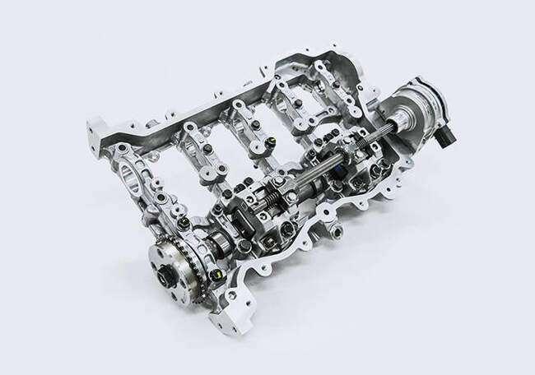
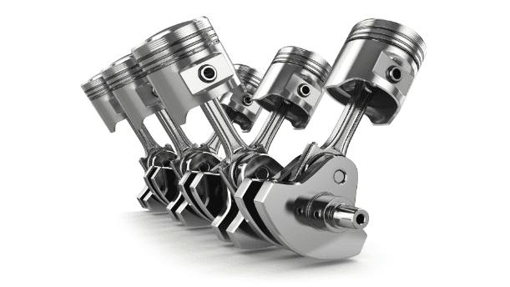
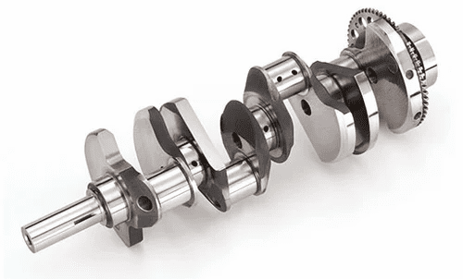
Understanding Engine Operation Principles
Engine Components
Cylinders: Chambers where combustion takes place.
Pistons: Move up and down, converting energy to motion.
Crankshaft: Converts piston's linear motion into rotation.
Camshaft: Controls valve timing (open/close).
Valves: Let air-fuel in and exhaust out at proper times.
Fuel Injection System: Delivers precise fuel into cylinders for efficient burning.

Slide 5
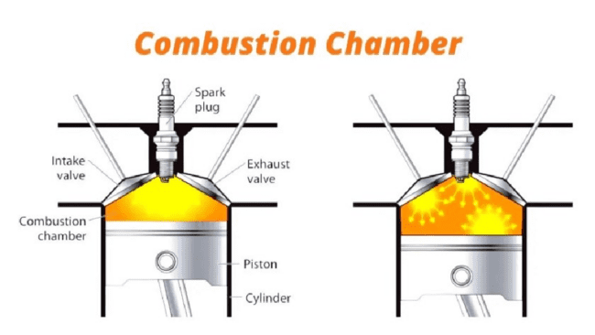
Understanding Engine Operation Principles
Combustion Process
Fuel-Air Mixture Preparation: Proper mix is crucial for power and economy.
Ignition Timing: Spark must fire at the right time for efficiency.
Combustion Chamber Design: Shape and design affect burning efficiency.
Exhaust Gas Recirculation (EGR): Reduces emissions by recirculating part of the exhaust.

Slide 6
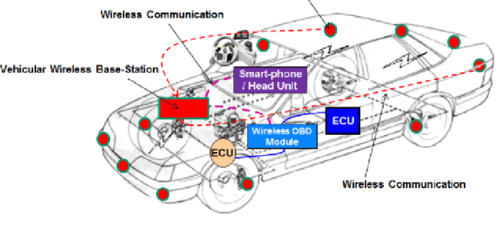
Understanding Engine Operation Principles
Engine Control Systems
Engine Control Unit (ECU): Brain of the engine that controls fuel, spark, etc.
Sensors: Monitor engine conditions (temperature, pressure, airflow, etc.).
Actuators: Carry out ECU commands (like opening injectors).
Control Algorithms: Software inside ECU makes decisions based on sensor input.

Slide 7
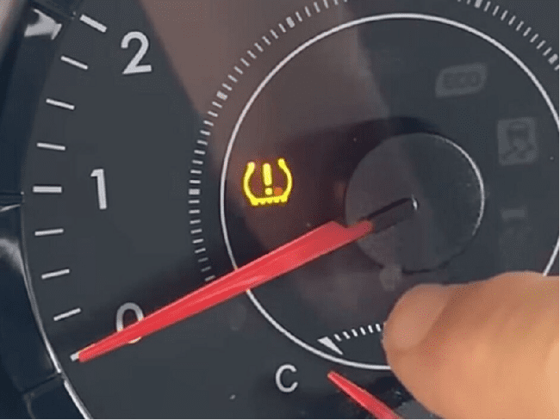
Diagnosing Engine Performance Issues
Visual Inspection: Look for leaks, wear, corrosion, or damage in hoses, etc.
Scan Tool Diagnostics: Retrieve and interpret DTCs using OBD-II tools.
Functional Tests: Compression test, fuel pressure test, ignition test, and exhaust gas analysis help pinpoint problems.
Symptom-Based Diagnosis: Use flowcharts, TSBs, and step-by-step guides to resolve symptoms.

Slide 8
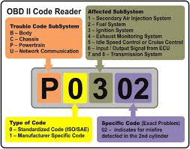
Interpretation of Engine Diagnostic Codes
DTC Analysis: Understand the format (e.g., P0301) and meaning of codes to locate issues.
Code Definitions: Use manuals and databases to identify the affected systems/components.
Code Clearing: Clear codes post-repair to confirm success and allow re-monitoring.
Intermittent Fault Diagnosis: Use live data, test drives, and sensor monitoring to diagnose faults that occur irregularly.

Slide 9

Conclusion
Engine performance analysis blends technical knowledge with diagnostic skill.
Mastery of this field ensures efficient, eco-friendly, and reliable engine operation—crucial as vehicle technology continues to evolve.

Slide 10
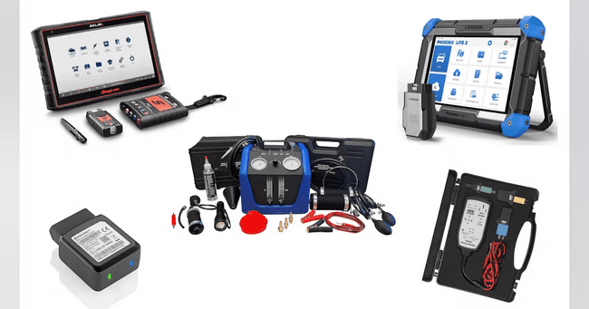

Self Assessment Preview
What are the four strokes involved in the Otto cycle, and what happens during each stroke?
How does the timing and sequence of the four strokes affect engine performance and efficiency?
Name three key engine components and describe their functions in engine operation.
quote by richard branson

Slide 11
Key Takeaways
Vehicles comprise interconnected systems: engine, transmission, braking, suspension, and electronics.
Each system affects overall vehicle performance; a fault in one can impact others.
A strong grasp of these systems allows technicians to trace faults and determine root causes.
Systematic knowledge forms the foundation for accurate diagnostics and effective repairs.

