Slide 1

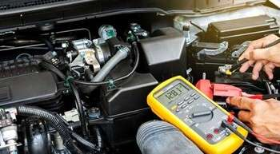
INTRODUCTION
UNIT 3.0
Electrical System Diagnostics
Understanding and Troubleshooting Automotive Electrical Systems

Slide 2
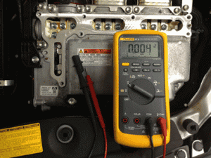

Introduction
Electrical systems are the nervous system of modern vehicles.
Understanding circuitry, components, and wiring diagrams is essential.
Skills needed include fault identification, analysis, and diagnostic techniques.
Goal: Equip you with solid diagnostic skills.

Slide 3
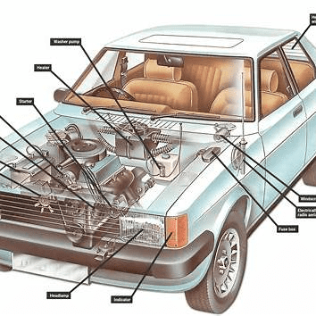
Basics of Automotive Electrical Systems
Foundation for effective diagnostics.
Focus Areas:
Circuitry
Components
Wiring Diagrams

Slide 4
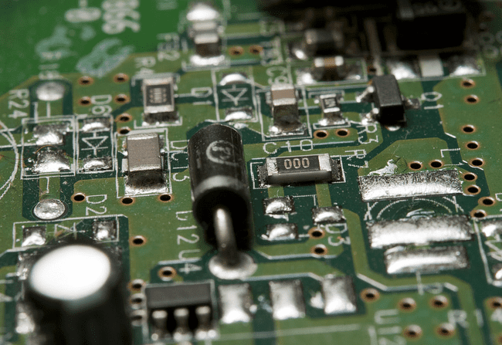
Circuitry
Definition: A path for electricity to flow through.
Series Circuit: One single path. If one part fails, the circuit breaks.
Parallel Circuit: Multiple paths. More reliable—one part can fail without affecting others.
Use in vehicles: Lights, sensors, and control modules.

Slide 5
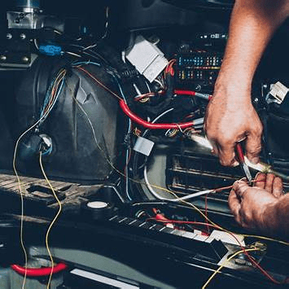
Components
Battery: Starts the engine and powers electronics.
Alternator: Charges the battery and powers the car when running.
Starter: Turns the engine over to start it.
Relays: Switch on high-power components like headlights.
Fuses: Prevent overload by breaking the circuit.

Slide 6
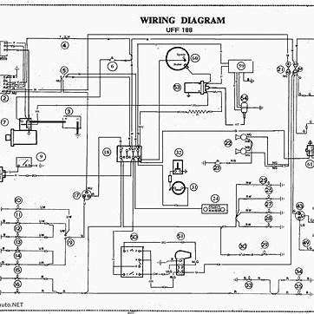
Wiring Diagrams
Shows electrical connections between components.
Includes wire colors, labels, symbols.
Helps in identifying circuits, faults, and component locations.
Essential for accurate repairs and communication.

Slide 7
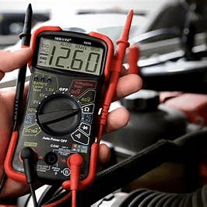
Identifying Electrical Faults
Approach:
Recognize symptoms
Perform a visual inspection
Use diagnostic tools
Follow step-by-step troubleshooting

Slide 8
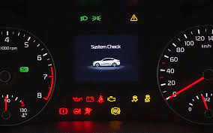
Symptom Recognition
Examples of Electrical Issues:
Flickering or dim lights
Dead radio or power windows
Blown fuses
Dashboard warning lights
Car won’t start

Slide 9
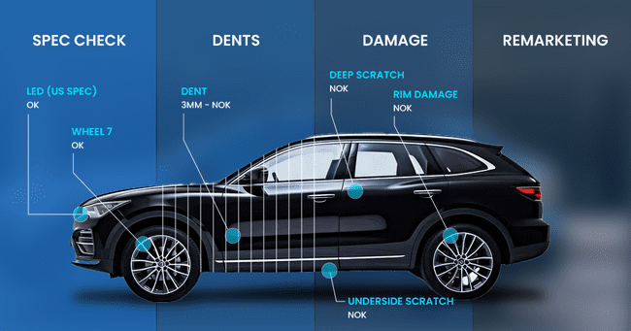
Visual Inspection
Check for:
Damaged wires or melted insulation
Corroded or loose battery terminals
Burnt connectors or blown fuses
Frayed or exposed wiring

Slide 10
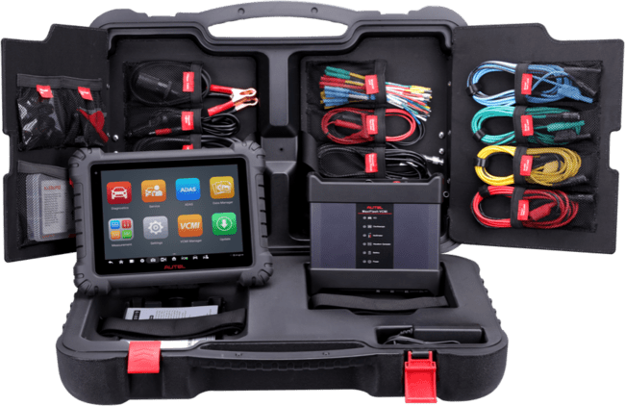
Diagnostic Tools
Multimeter: Measures voltage, resistance, and continuity
Circuit Tester/Power Probe: Finds voltage and ground
OBD-II Scanner: Reads trouble codes from the vehicle’s computer
Load Tester: Tests battery under demand

Slide 11
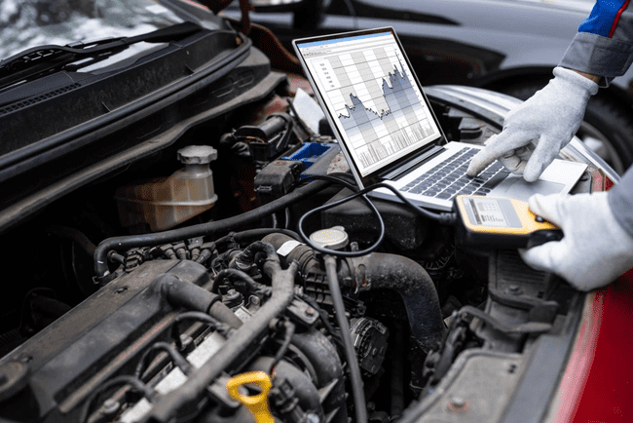
Systematic Troubleshooting
Techniques:
Voltage Drop Test: Checks for resistance in a circuit
Continuity Test: Ensures wires aren’t broken
Component Tests: Starter draw, alternator output, battery load test

Slide 12
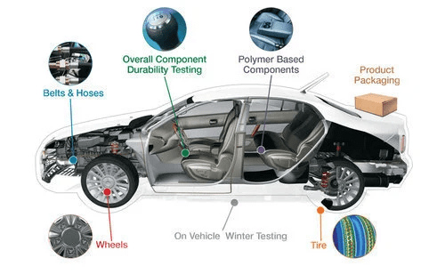
Component Testing
Battery: Use a voltmeter – should read around 12.6V
Alternator: With engine running, should charge at 13.5 – 14.5V
Starter: Measure cranking voltage; check current draw
Accessories: Confirm power supply, ground, and switch function

Slide 13

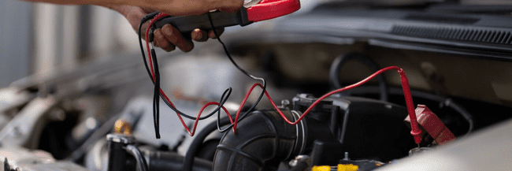
Conclusion
A vehicle’s electrical system is complex but critical.
Proper diagnostics save time, money, and ensure safety.
Constant learning is key as vehicles become more high-tech.

Slide 14

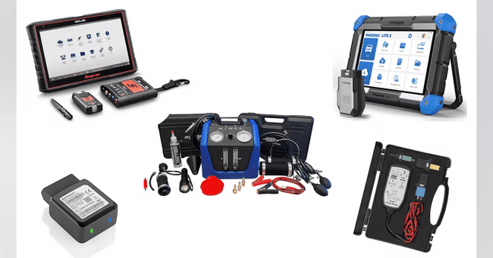
Self Assessment Preview
Explain the difference between series and parallel circuits in automotive electrical systems.
What are the essential components of automotive electrical systems, and how do they contribute to vehicle functionality?
Why is interpreting wiring diagrams crucial for technicians dealing with vehicle electrical issues?
quote by richard branson

Slide 15
Key Takeaways
The diagnostic process includes complaint verification, preliminary checks, testing, diagnosis, and repair verification.
Logical, step-by-step procedures are essential for efficient diagnostics.
Technicians must document findings, analyze symptoms, and consult repair data before taking action.
Accurate problem identification prevents unnecessary repairs and increases customer satisfaction.

