Slide 1

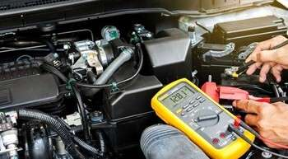
INTRODUCTION
UNIT 4.0
On-board Diagnostics (OBD) Systems
Understanding OBD Technology in Modern Vehicles

Slide 2
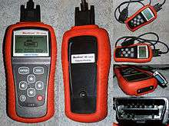
Introduction
OBD systems: a cornerstone in modern vehicle management
Network of sensors, monitors, diagnostic protocols
Supports:
  Performance monitoring
  Emissions compliance
  Proactive maintenance
Facilitates communication with diagnostic tools
Standardized by OBD-II protocols
quote by richard branson

Slide 3
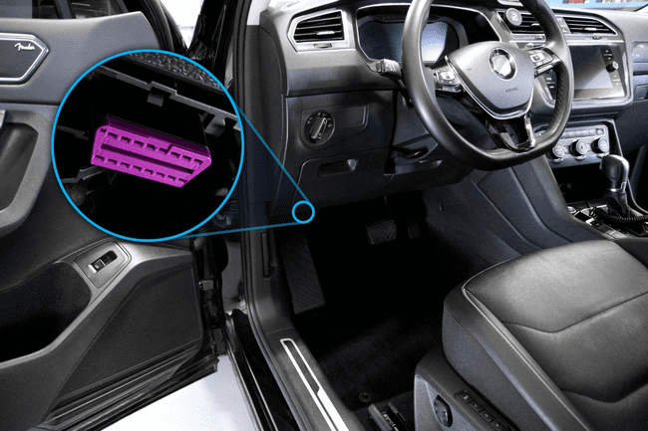

Introduction to OBD Systems and their Significance
Real-time monitoring and diagnostics
Ensures optimal performance and emissions control
Identifies anomalies before breakdowns occur
Reduces repair costs
Enhances vehicle reliability and driving experience

Slide 4
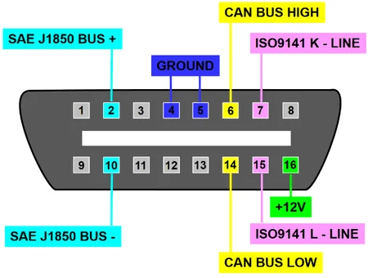
OBD-II Standards and Protocols (1)
Universal framework across all vehicle brands
Covers:
  Protocols
  Communication specs
  Data parameters
Standardized Diagnostic Trouble Codes (DTCs)

Slide 5
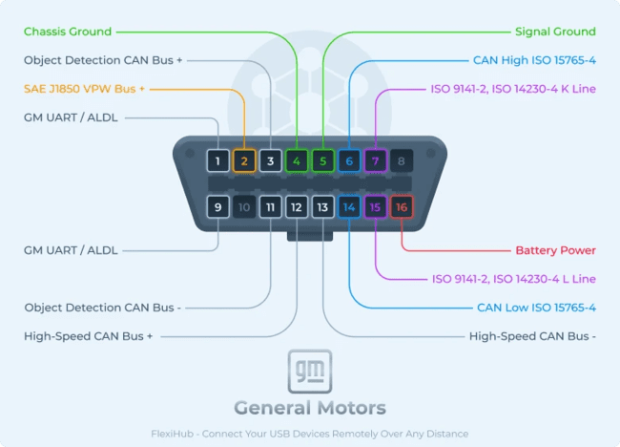
OBD-II Standards and Protocols (2)
Use of standardized connectors
Easy access via scan tools
Promotes:
  Interoperability
  Efficiency
  Transparency
Improves technician diagnostics and service quality

Slide 6
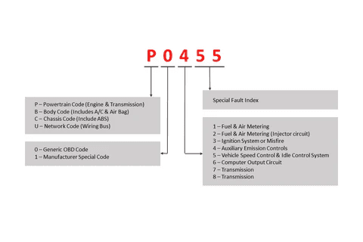
Interpretation and Analysis of OBD Diagnostic Codes (1)
DTCs = alphanumeric codes showing vehicle issues
Retrieved using scan tools
Interpreted using databases and definitions
Informs repair and diagnostic decisions

Slide 7
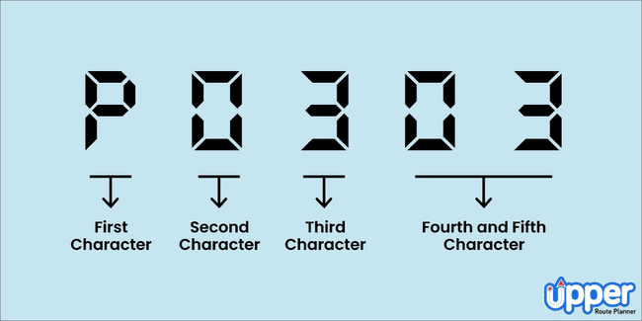
Interpretation and Analysis of OBD Diagnostic Codes (2)
Common OBD-II DTCs:
P0300 – Random/Multiple Cylinder Misfire
P0420 – Catalyst Efficiency Below Threshold
P0171 – System Too Lean (Bank 1)
P0128 – Coolant Thermostat Below Regulating Temp
P0442 – Evaporative Emission System Leak (Small)
P0505 – Idle Air Control System Malfunction

Slide 8
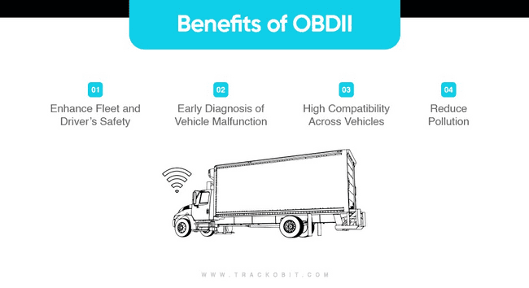
Benefits of OBD Code Analysis
Reduces diagnostic time and guesswork
Enables precise repairs
Minimizes vehicle downtime
Boosts customer trust and satisfaction
Cost-effective service delivery

Slide 9
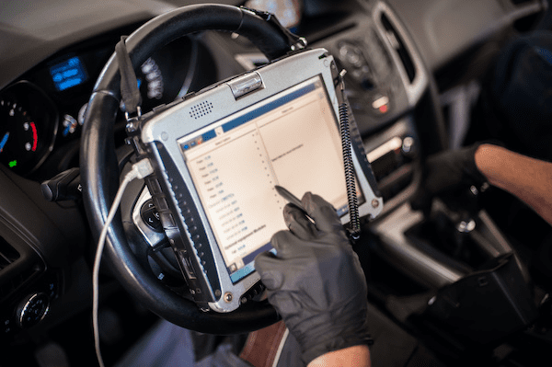
Conclusion
OBD systems ensure vehicle health and compliance
Standardized through OBD-II for easier maintenance
Help reduce environmental impact
Key in modern vehicle diagnostics and future innovations

Slide 10

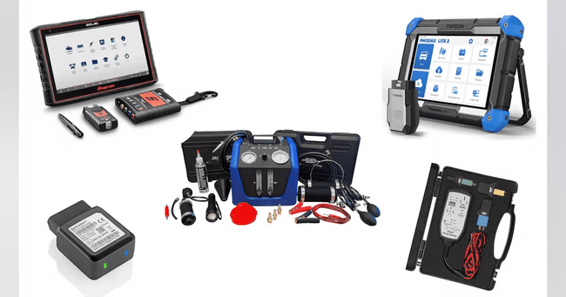
Self Assessment Preview
What is the primary purpose of OBD systems?
How do OBD systems aid in preventive maintenance?
How do OBD systems support emissions compliance?
What components are monitored by OBD systems?
Role of DTCs in OBD-II?
quote by richard branson

Slide 11
Key Takeaways
OBD systems monitor and report the status of key vehicle functions.
They generate Diagnostic Trouble Codes (DTCs) to help pinpoint faults.
OBD-II is the standardized system used in modern vehicles for emissions and performance monitoring.
Understanding OBD systems helps technicians read, interpret, and clear codes effectively.

