Slide 1

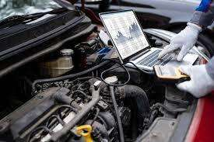
INTRODUCTION
UNIT 5.0
Diagnostic Tools and
Techniques
Utilizing Scan Tools and Diagnostic Software

Slide 2
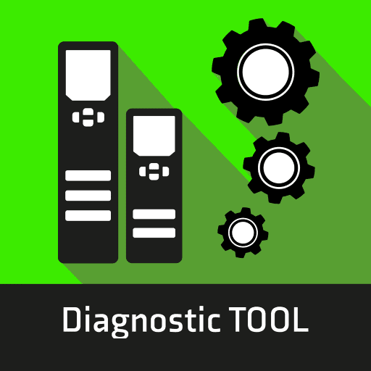
Overview
Automotive diagnostics use a wide array of tools—from basic to advanced.
Basic tools:
Multimeters
Circuit testers
Vacuum gauges
Used for assessing electrical and mechanical integrity.
quote by richard branson

Slide 3
Introduction
Diagnostic tools and techniques are vital in modern vehicle maintenance and repair.
These tools range from handheld devices to advanced electronic systems.
When paired with expert techniques, they help technicians navigate complex vehicle systems and resolve malfunctions.
This module explores tools' functionalities, scan tools and software, and practical applications for vehicle reliability and safety.
quote by richard branson

Slide 4
Introduction
Diagnostic tools and techniques are vital in modern vehicle maintenance and repair.
These tools range from handheld devices to advanced electronic systems.
When paired with expert techniques, they help technicians navigate complex vehicle systems and resolve malfunctions.
This module explores tools' functionalities, scan tools and software, and practical applications for vehicle reliability and safety.
quote by richard branson

Slide 5
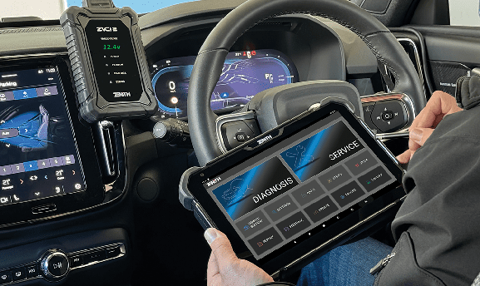
Advanced Diagnostic Equipment
Scan tools:
  Interface with on-board computer systems.
  Retrieve Diagnostic Trouble Codes (DTCs).
  Monitor live data.
  Offer bi-directional control for testing and verification.
Oscilloscopes: Analyze electrical signals and sensor anomalies.
Emissions analysers: Measure exhaust gas for emissions compliance.
quote by richard branson

Slide 6
Utilising Scan Tools and Diagnostic Software
Scan Tools:
Connect with the vehicle’s OBD system.
Retrieve DTCs, monitor real-time data.
Diagnostic Software:
Provides repair procedures and technical specifications.
Offers DTC definitions, flowcharts, and troubleshooting guides.
quote by richard branson

Slide 7

Features of Diagnostic Software
Graphical visualization of sensor readings and system behavior.
Enhanced accuracy in spotting anomalies or trends.
Real-time component activation and functional testing.
quote by richard branson

Slide 8


Hands-On Practice with Diagnostic
Procedures
Provides real-world problem-solving experience.
Use of tools: scan tools, multimeters, oscilloscopes.
Learn to retrieve and interpret DTCs and live data.

Slide 9

Benefits of Hands-On Practice
Familiarity with tool operation and software interfaces.
Develop confidence and systematic diagnostic methods.
Encourages critical thinking, decision-making, and teamwork.
quote by richard branson

Slide 10
Conclusion
Diagnostic tools and techniques are essential for ensuring vehicle reliability and performance.
Mastery of scan tools, software, and hands-on methods is crucial.
As technology evolves, technicians must keep up with advancements to maintain high standards.

Slide 11

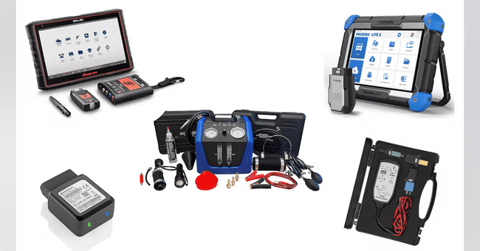
Self Assessment Preview
What is the role of diagnostic tools and equipment in automotive diagnostics?
Describe the foundational diagnostic tools used by technicians.
How do scan tools enhance diagnostic capabilities?
Explain the functionalities of oscilloscopes and emissions analysers.
Why is tool proficiency essential for safety?
quote by richard branson

Slide 12
Key Takeaways
A systematic approach is key to diagnosing electrical issues.
Using diagnostic tools helps keep vehicles safe and running well.
Using tools in practice helps technicians learn and solve problems better.
Understanding data and using smart strategies leads to faster, accurate fixes.
Technicians need to keep up with new tools and software to do their job well.

